Slide 1

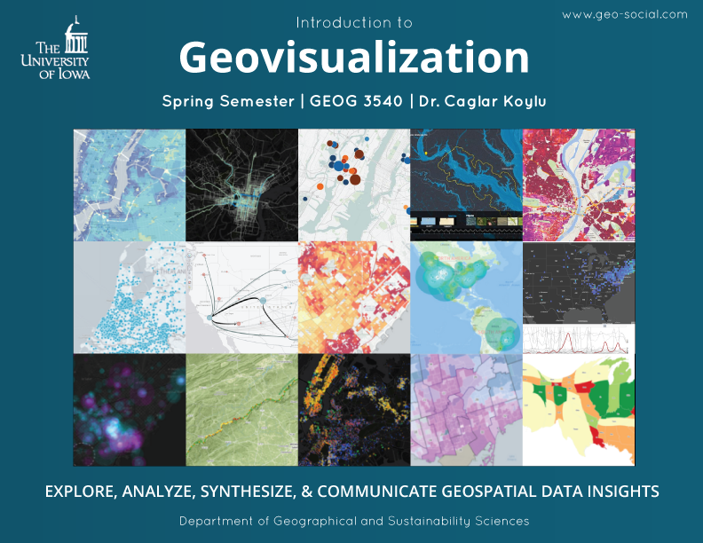
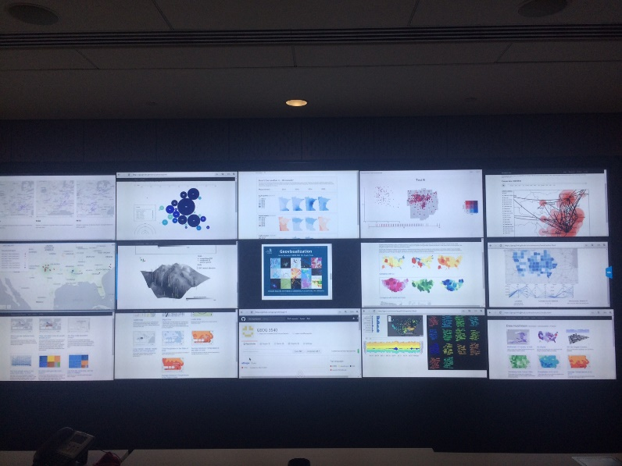


Geovisualization and Web Mapping
@caglarkoylu
Assistant Professor
Department of Geographical and Sustainability Sciences
www.geo-social.org/datascience

Slide 2
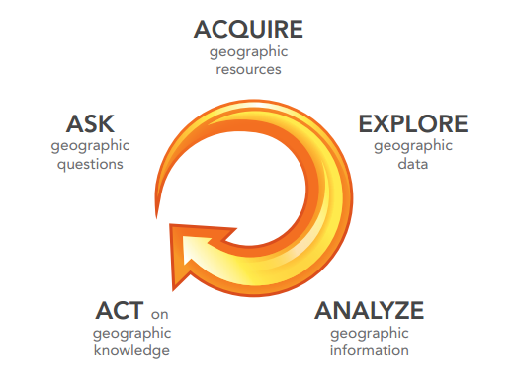
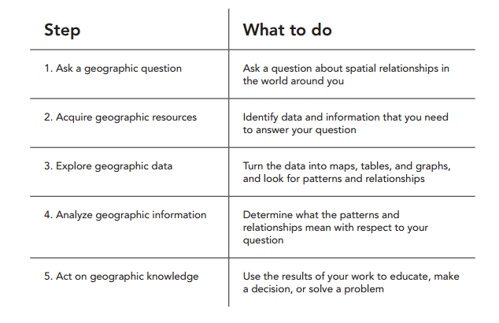
Thinking Spatially
ESRI, 2011

Slide 3
What is a Geographic Information System (GIS)?
So, different definitions have evolved in different areas and disciplines, BUT all recognize:
Geographical data are unique
At a minimum, a GIS consists of:
A data input subsystem
A data storage and retrieval system
A data manipulation and analysis subsystem
A reporting subsystem (data output)
A GIS as a layered cake (http://www.saylor.org/site/textbooks/Essentials%20of%20Geographic%
20Information%20Systems.pdf)

Slide 4
What is Geographic Information Science?
GIScience is the scientific discipline that studies data structures, computational and visualization techniques to capture, process, analyze and visualize geographic information.
Convergence of Cartography with Information Sciences
Focus on “generic issues that surround the use of GIS technology, impede its successful implementation, or emerge from an understanding of its potential capabilities.”(Goodchild, 1992)

Slide 5

Geovisualization
“Geovisualization is a private activity (visual thinking) in which unknowns are revealed in a highly interactive environment”
“Whereas communication is the opposite: a public activity in which knowns are presented in a non-interactive environment”
MacEachren, 1994

Slide 6

Why have a human in the loop?

Slide 7
Why have a human in the loop?
don’t need visualization when fully automatic solution exists and is trusted
many analysis problems ill-specified
don’t know exactly what questions to ask in advance
possibilities
long-term use for end users (e.g. exploratory analysis of scientific data)
presentation of known results
stepping stone to better understanding of requirements before developing models
help developers of automatic solution refine/debug, determine parameters
help end users of automatic solutions verify, build trust
Munzner, 2015

Slide 8
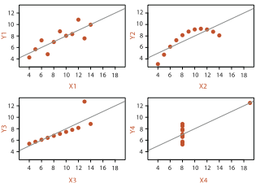
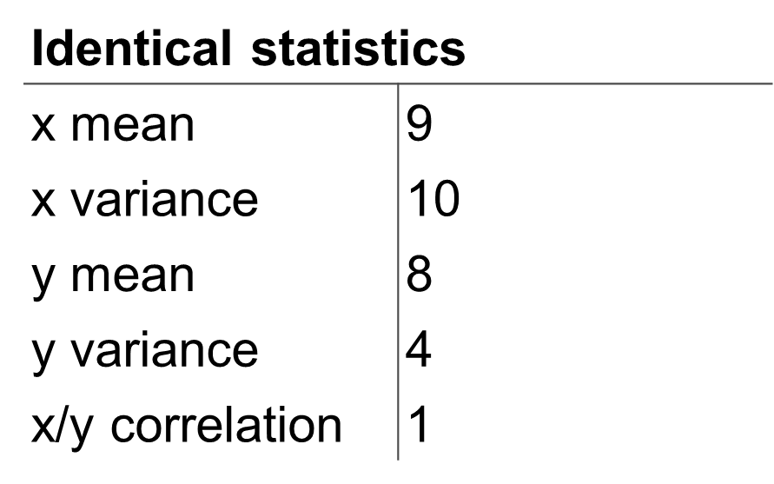
Why represent all the data?
Summaries lose information, details matter
Confirm expected and find unexpected patterns
Assess validity of statistical model
Anscombe’s Quartet

Slide 9
Geovisualization
Nature of geographic phenomena
Level of measurement
Visual variables
Map types

Slide 10
Nature of Geographic Phenomena
Primitives in geographic space
Direction, distance, scale, location, distribution,
The concepts of geography and spatial analysis
Spatial association
Distance decay
Forms and Processes (Spatial Randomness, Dispersion, Clustering)
Spatial Interaction
Space-time

Slide 11
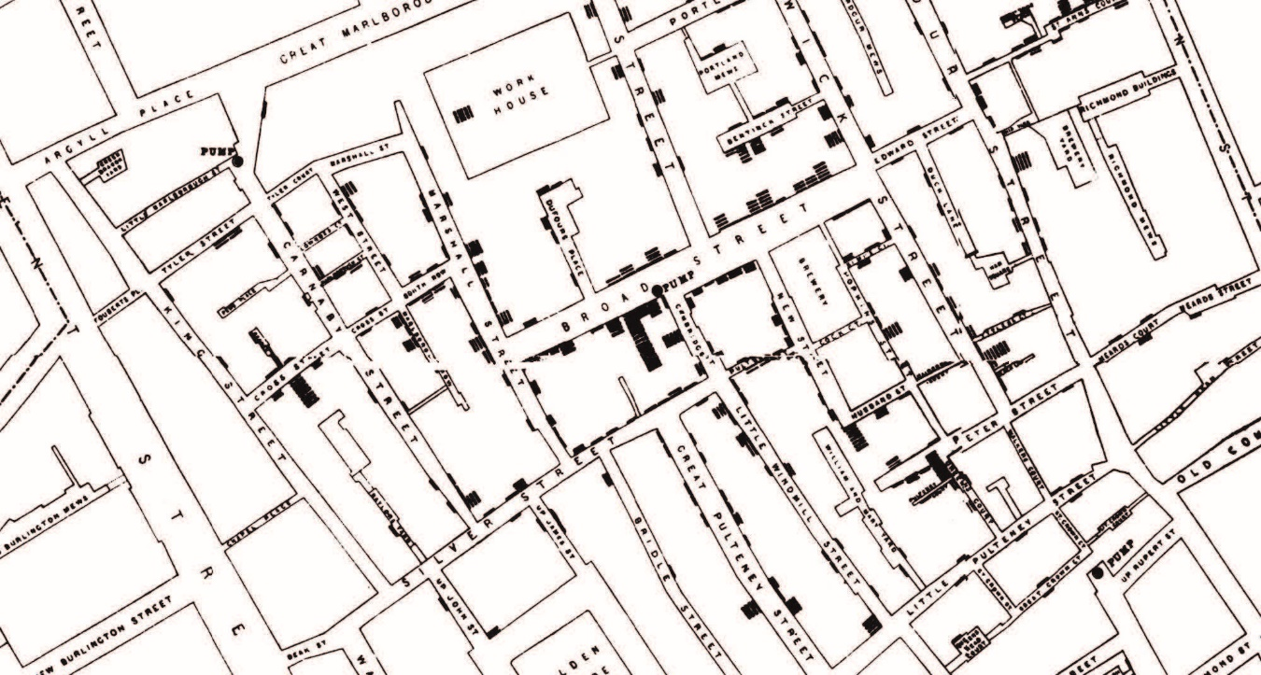
Spatial Association
Spatial location of a variable with respect to another or others functionally or causally related to it.

Slide 12
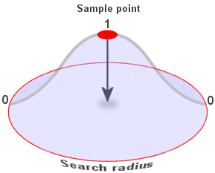
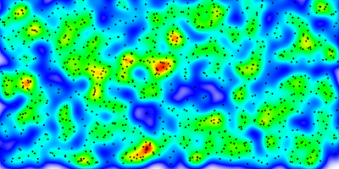
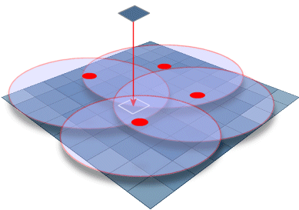
Distance decay

Slide 13
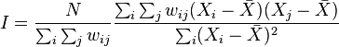
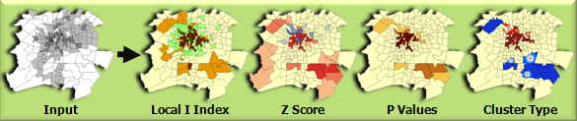
Distance decay

Slide 14
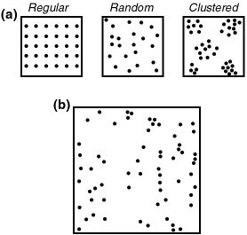
Forms and processes

Slide 15
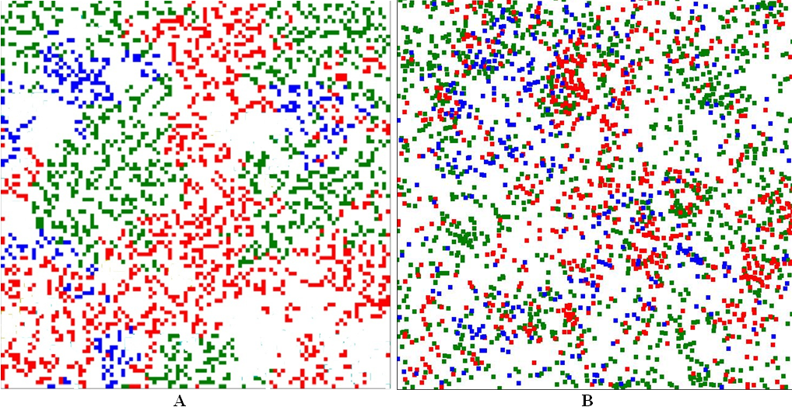
Forms and processes

Slide 16
Levels of measurement
Nominal
Ordinal
Interval
Ratio
Interval & ratio are called “numerical data”

Slide 17
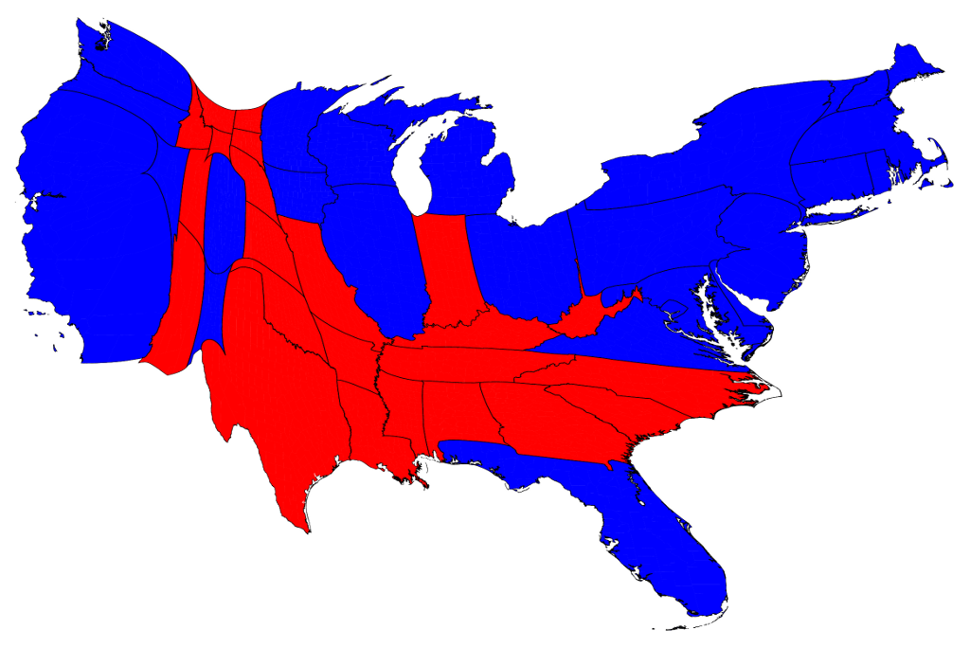
Nominal (Categorical)
A qualitative map displays portrays categorical (i.e., nominal) data such as vegetation types, winning parties, etc.

Slide 18
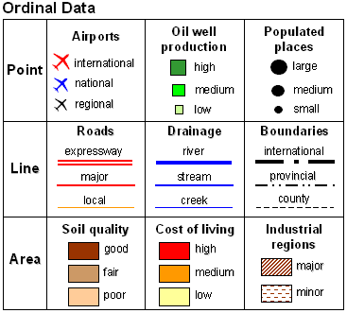

Ordinal

Slide 19
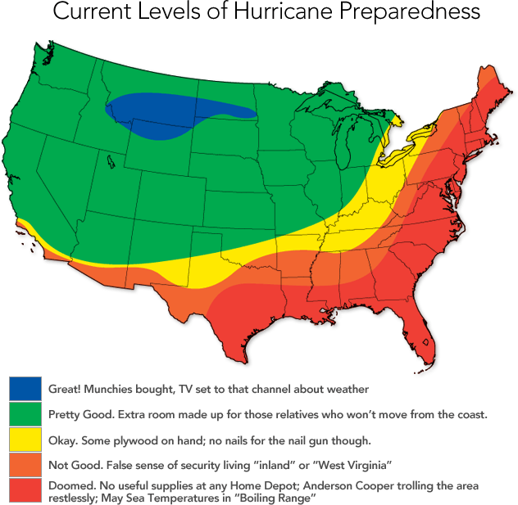
Ordinal

Slide 20
Interval
Ordering plus an indication of a numerical difference
But you can’t fully compare interval data…
Can measure distance between measurements
Can’t always directly compare measurements
There is a problem of no “set” 0
Classic example: temperature in F or C

Slide 21
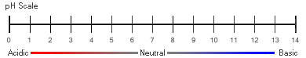
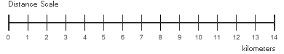
Interval and Ratio
Interval
Ratio

Slide 22
Interval & Ratio
Degrees F (Interval)
Is 40 degrees four times as warm as 10 deg.?
We can only say that it is 30 degrees warmer
This is because of “arbitrary zero points”
Ratio has set zero
Counts with set zeros, or ratios of multiple values
Money ($40 is four times more than $10)
10 students is twice as many as 5
Most mapped data expresses a ratio (%, # per 100,000, etc.)

Slide 23
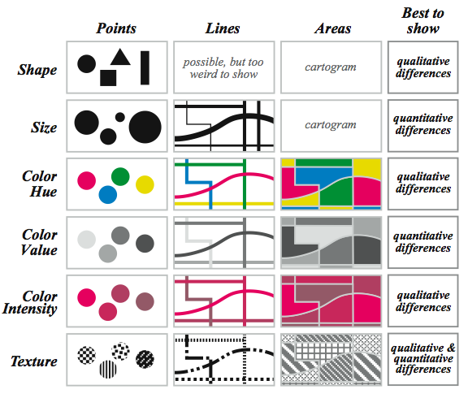
Visual Variables
Krygier and Wood, 2002

Slide 24
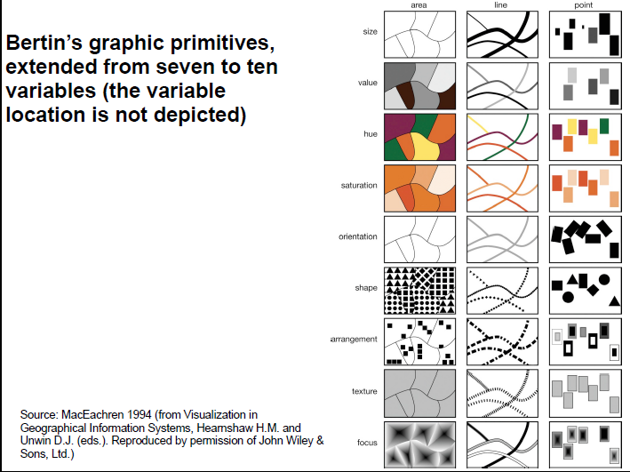
Visual Variables

Slide 25
Map Types
Maps can help us answer several types of questions
Where? Shows us the spatial location and arrangement of locations.
E.g., Where is Iowa?
What? Gives us information on the attributes of locations.
E.g., What is the predominant land use in Iowa?
When? Provides snapshots (and change) in attributes of locations over time.
E.g., When were the most acres of land in corn production in Iowa?

Slide 26
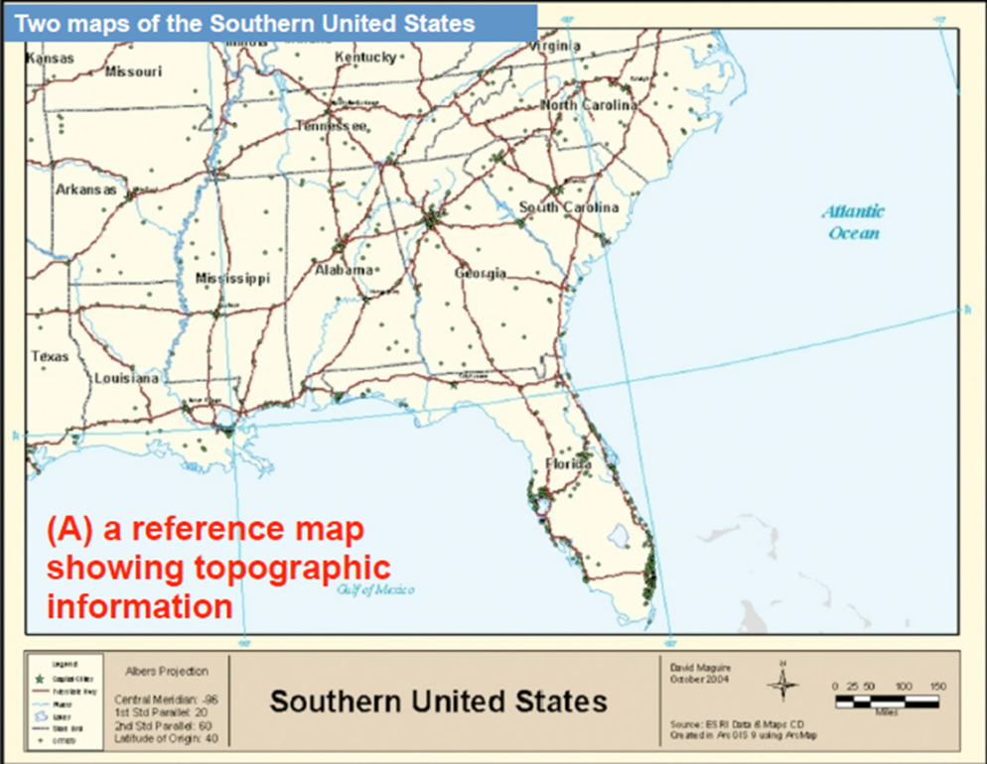
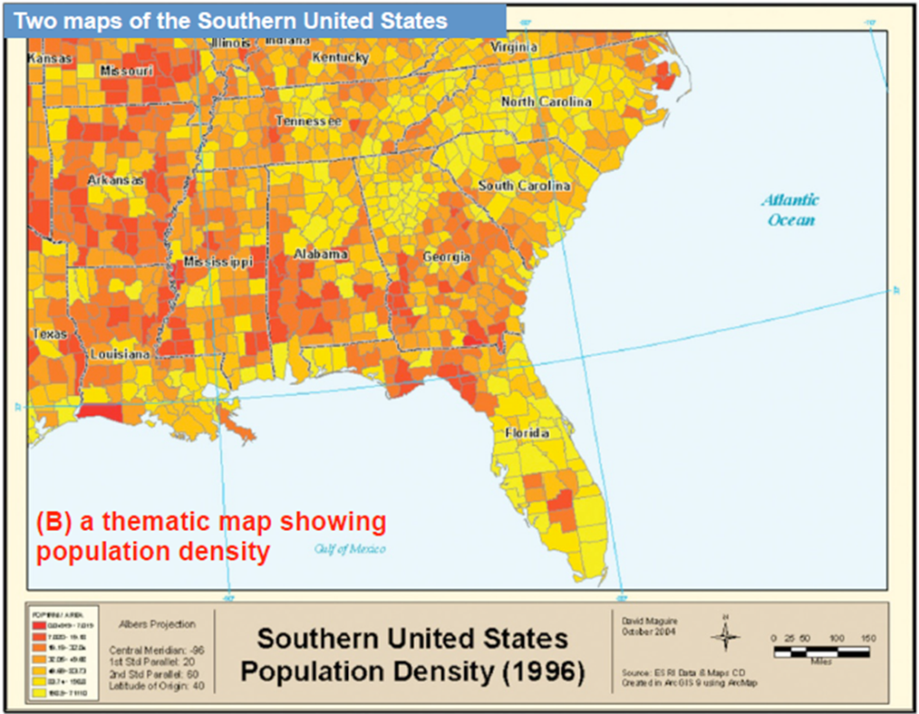
Map Types
Reference
Visualizes the Earth’s surface as accurately as possible for a given scale. Sometimes divided into physical and political types.
Thematic
Represent the distribution of particular themes. Sometimes further sub-divided in to physical and socio-economic themes.

Slide 27
Thematic maps
Some common types of thematic maps:
Point (point density/dot/dot density) maps
Graduated (proportional) symbol maps
Isarithmic (isopleth/isoline) maps
Choropleth maps
Cartograms
Flow maps

Slide 28
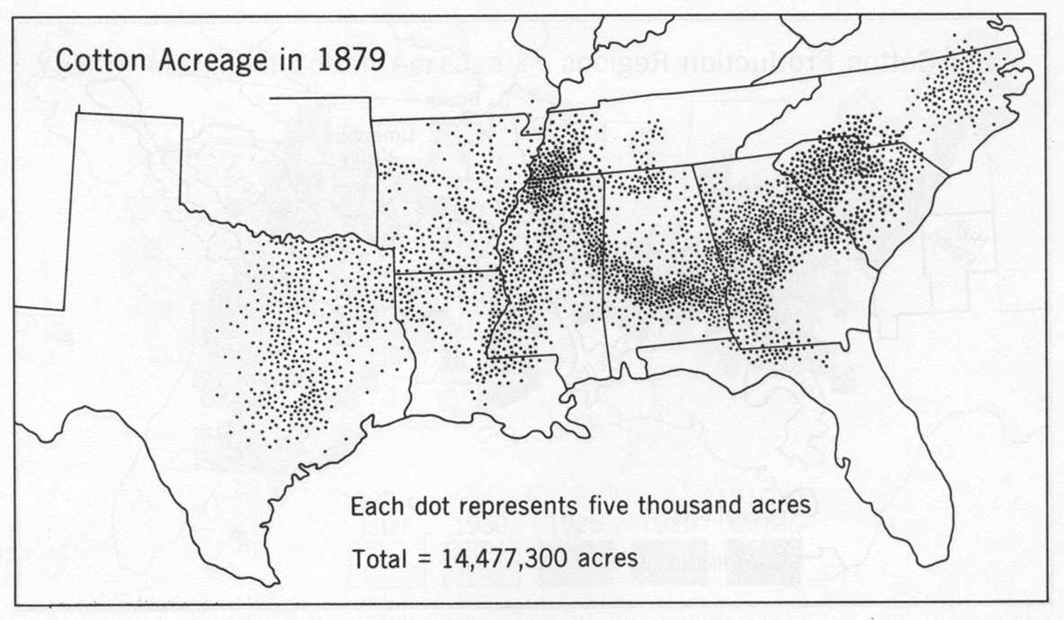
Dot maps & time

Slide 29
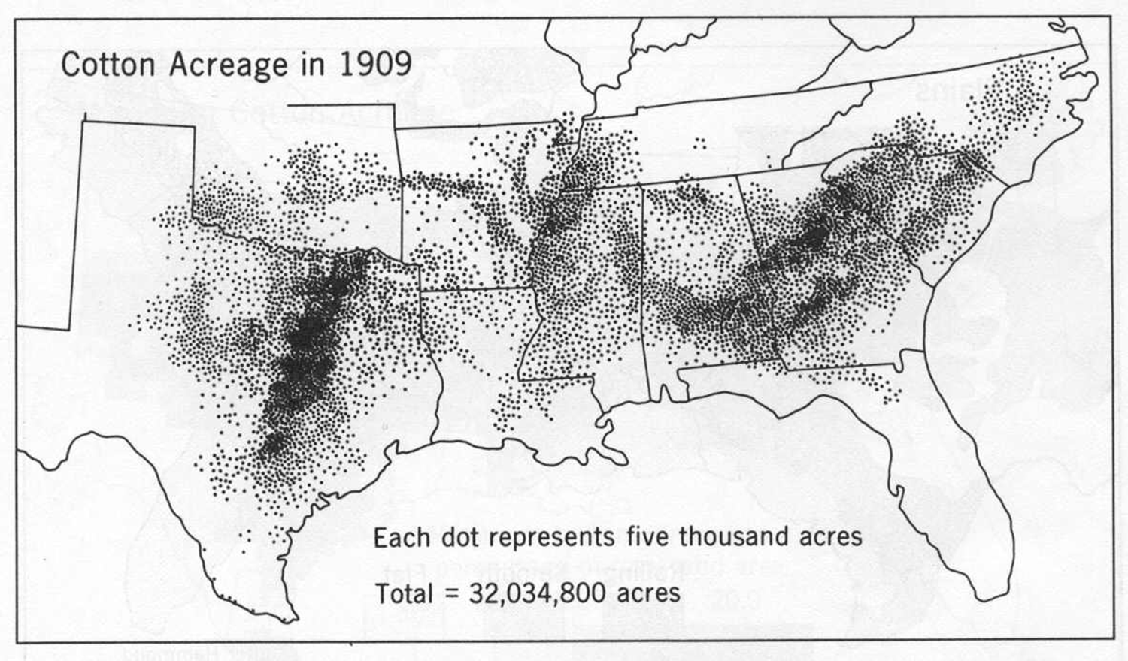
Dot maps & time

Slide 30
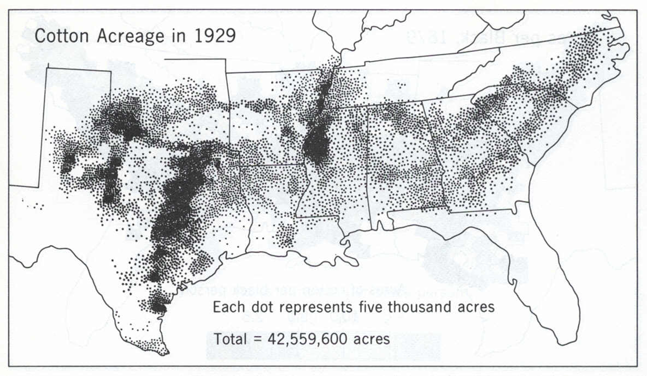
Dot maps & time

Slide 31
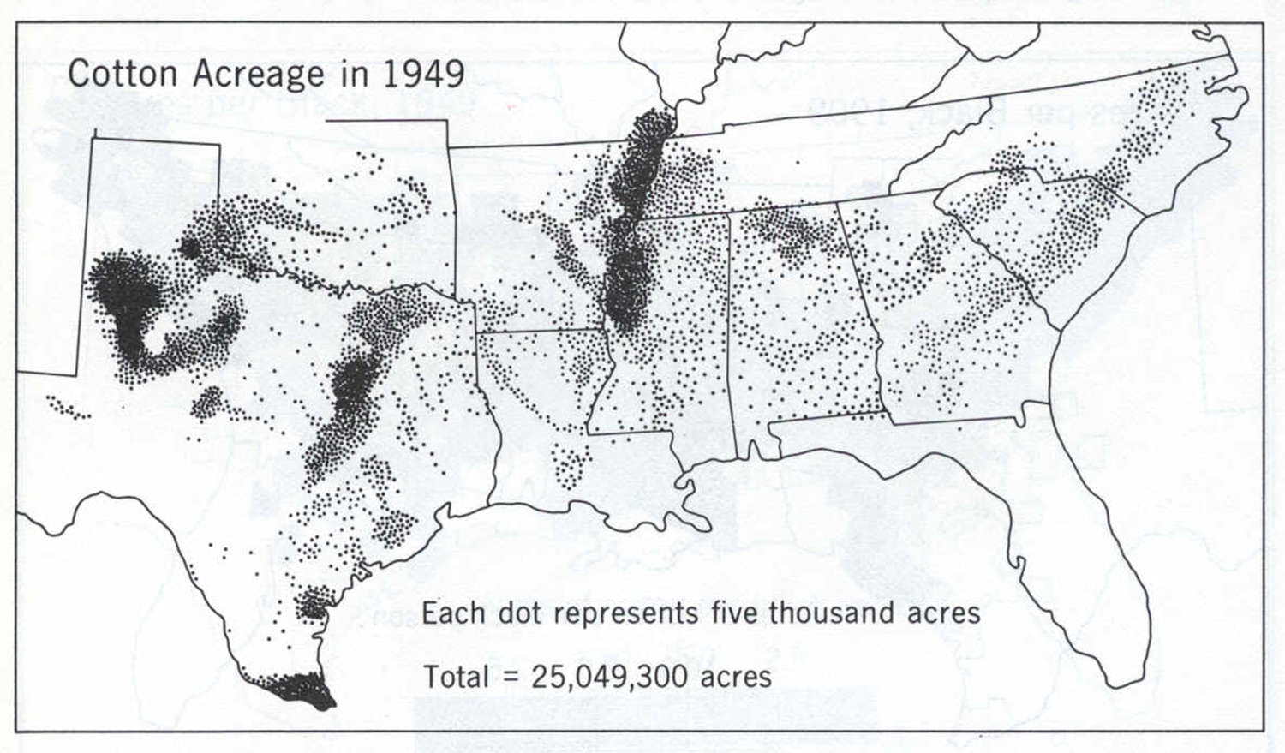
Dot maps & time

Slide 32
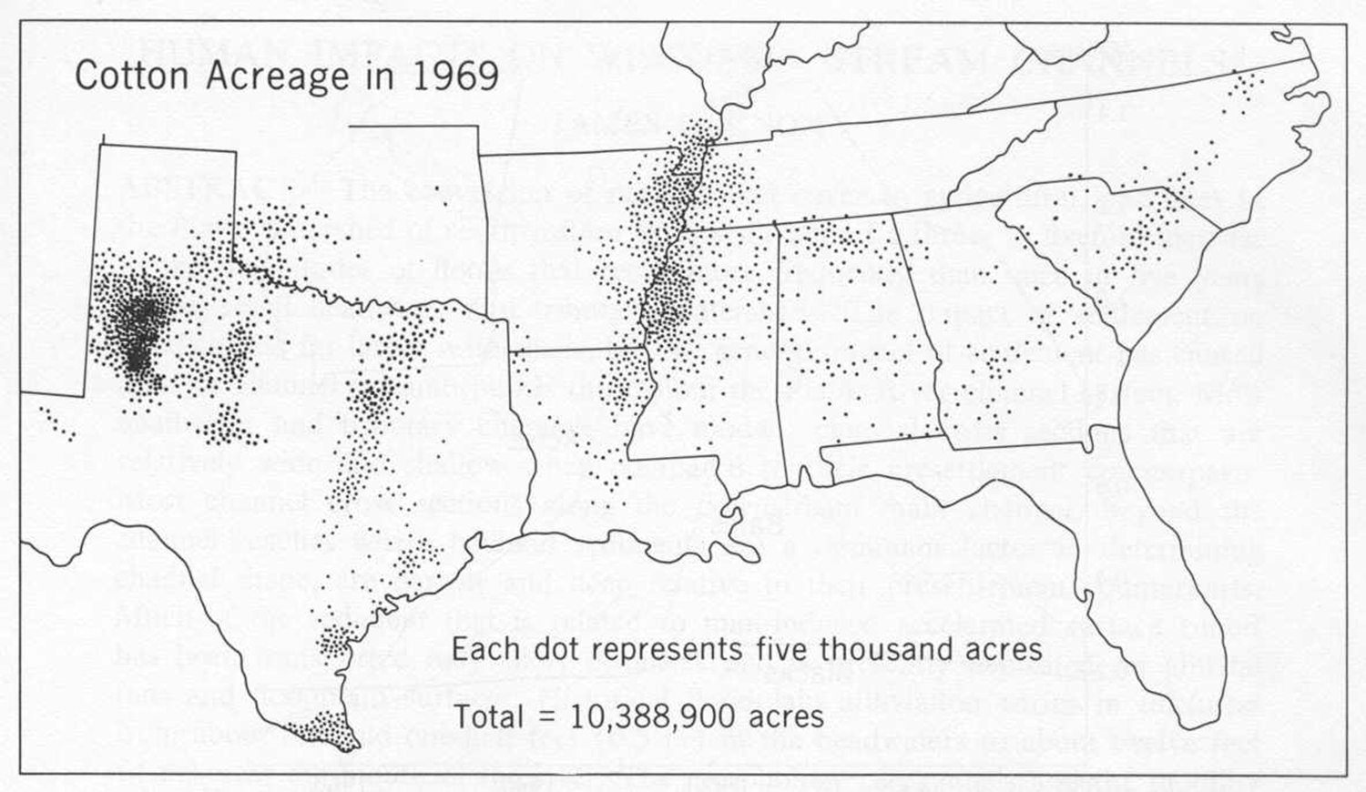
Dot maps & time
Time series: Hart, Annals AAG

Slide 33
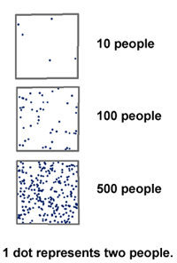
Dot maps: final notes
Legend:
Consider providing multiple examples of densities of dots
= visual anchors
Limitations:
Cannot retrieve rates or numbers from map

Slide 34
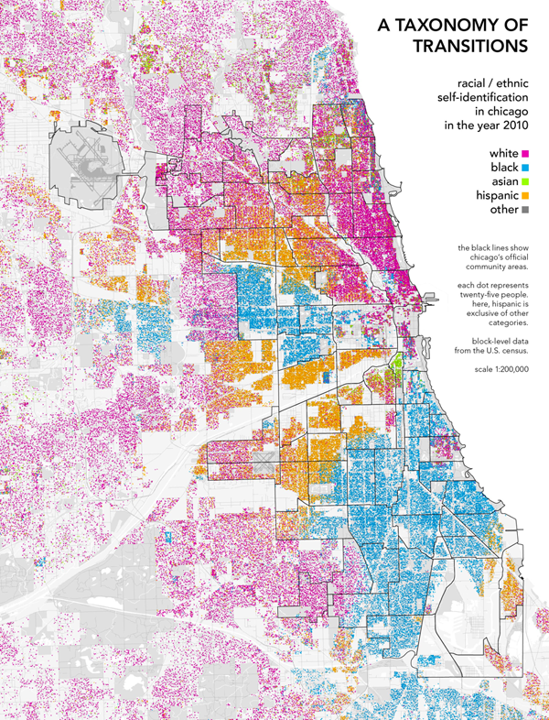
Dot maps
Example of multivariate (multiple variables)
http://www.radicalcartography.net/index.html?chicagodots.

Slide 35
Graduated/Proportional Symbol maps
Contain symbols varying in size to show their relative quantitative values
Used with point/location data; also good choice for count data (raw data), but ratios can also be used (e.g., percent)
Goal is to show relative magnitudes of phenomena at specific locations
Manipulate symbol size to show magnitude (numerical value) as the visual variable

Slide 36
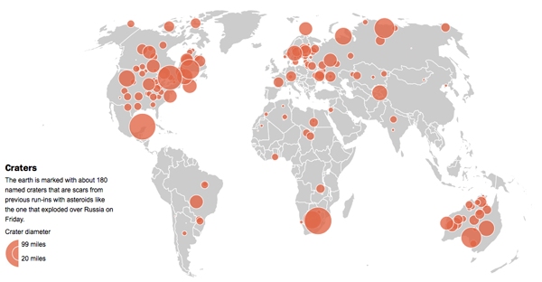
Proportional symbols
Legend design is one option
The Washington Post

Slide 37
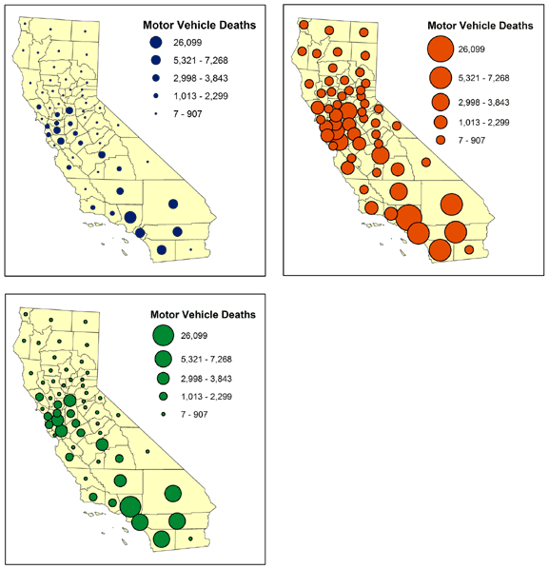
Graduated symbols
Range-graded symbols

Slide 38
Isarithmic (Isopleth/Isoline) maps
Portrays continuous surfaces using isolines
Quantitative line features
Each isoline represents a constant value
Surfaces may be:
Real (e.g., topographic, barometric, temperature, etc.)
Conceptual (e.g., population density)
Interval between isolines important

Slide 39
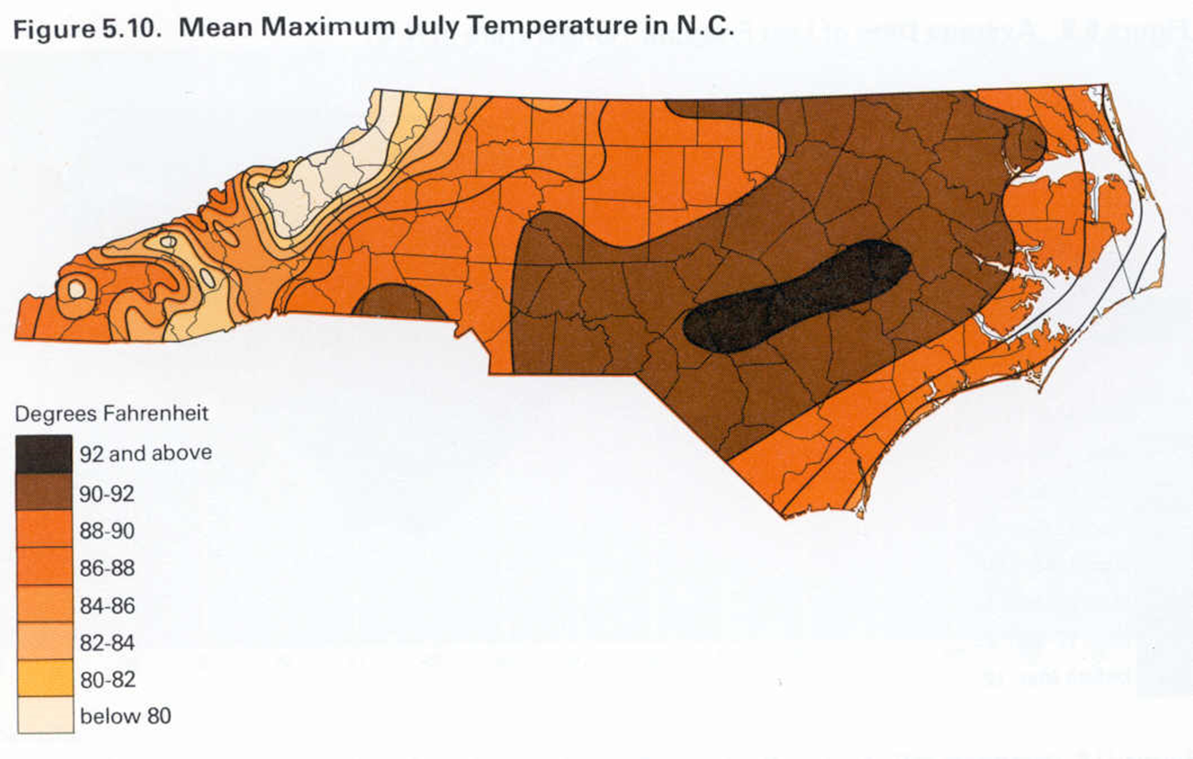
Isarithmic (Isopleth/Isoline) maps

Slide 40
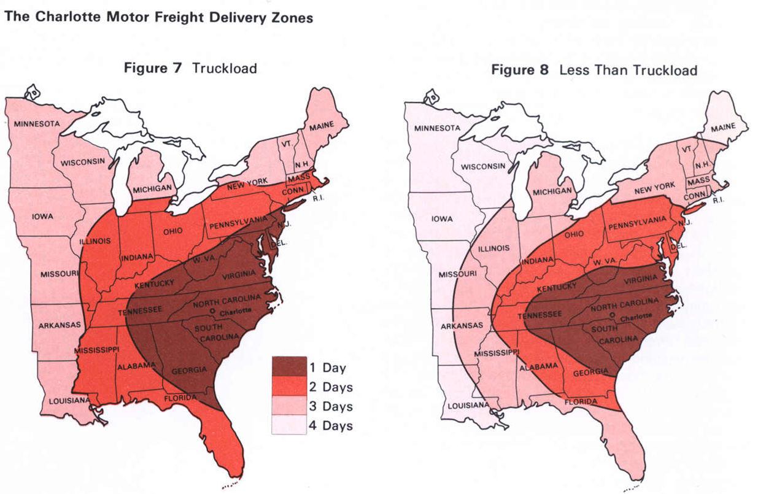
Isarithmic (Isopleth/Isoline) maps

Slide 41
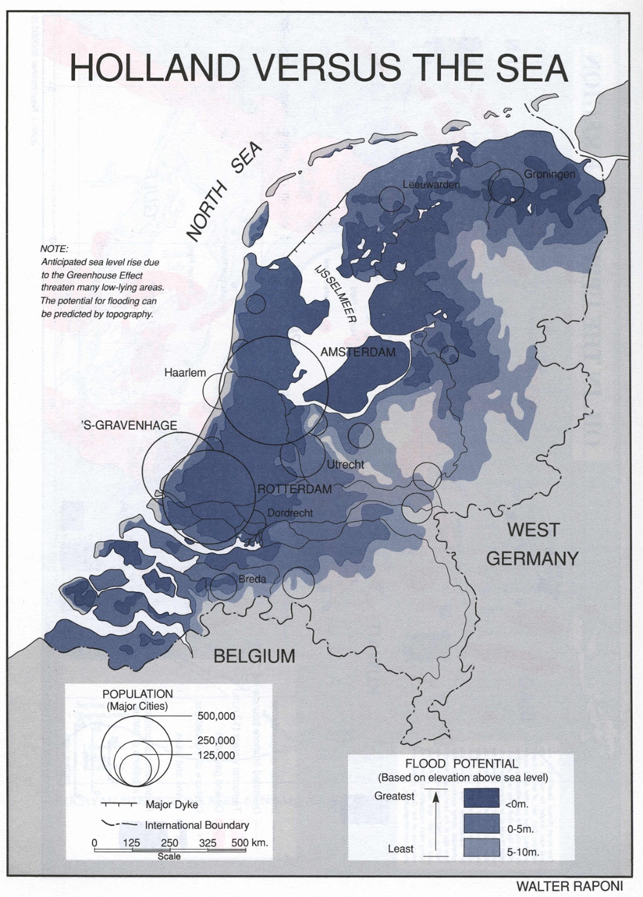
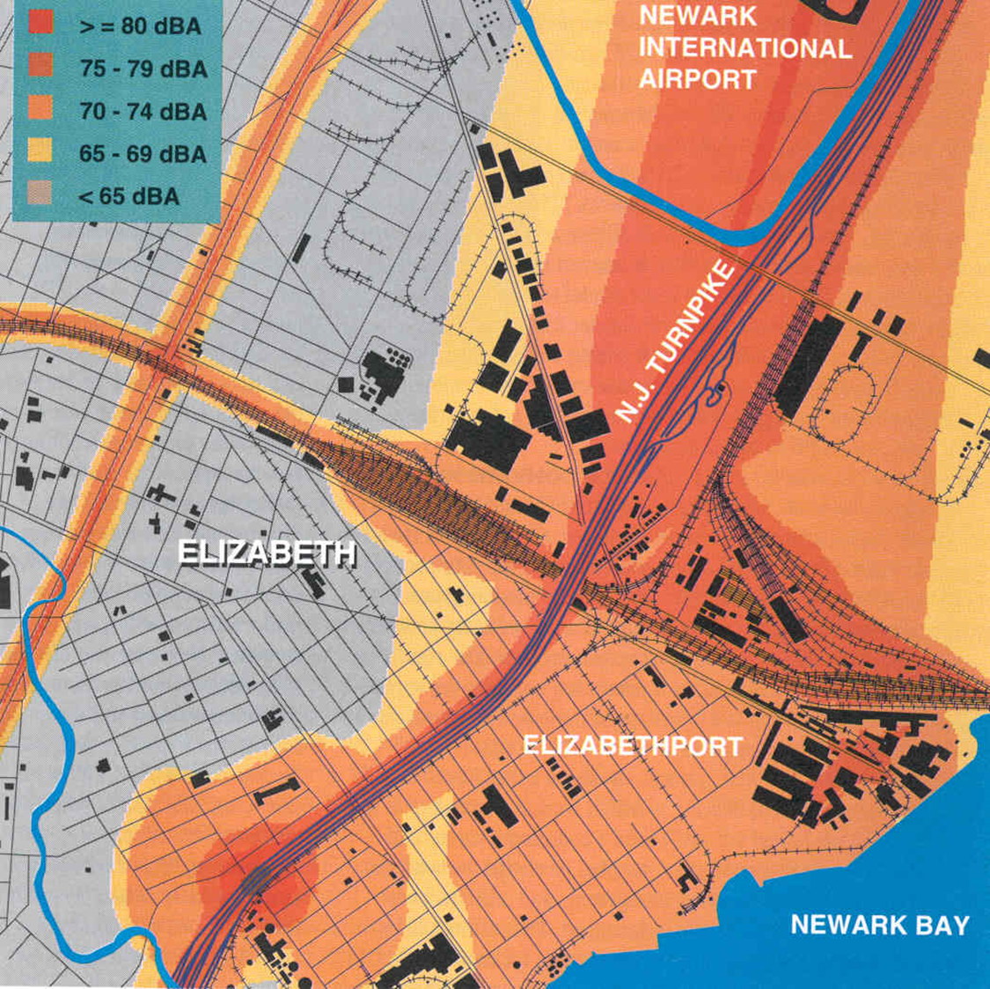
Isarithmic (Isopleth/Isoline) maps

Slide 42

Flow Maps – Napoleon’s March to Moscow in 1812
Notes:
Minard’s chart shows six types of information: geography, time, temperature, the course and direction of the army’s movement, and the number of troops remaining. The widths of the gold (outward) and black (returning) paths represent the size of the force, one millimetre to 10,000 men. Geographical features and major battles are marked and named, and plummeting temperatures on the return journey are shown along the bottom.

Slide 43
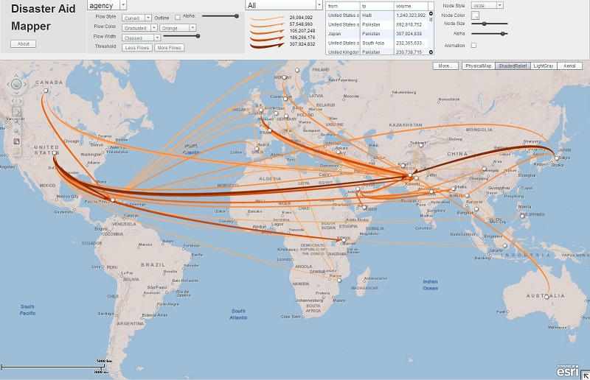
Flow Maps – Flows of disaster aids
Koylu, 2014: http://129.252.37.169:8400/flowvis/disasteraid/index.html

Slide 44
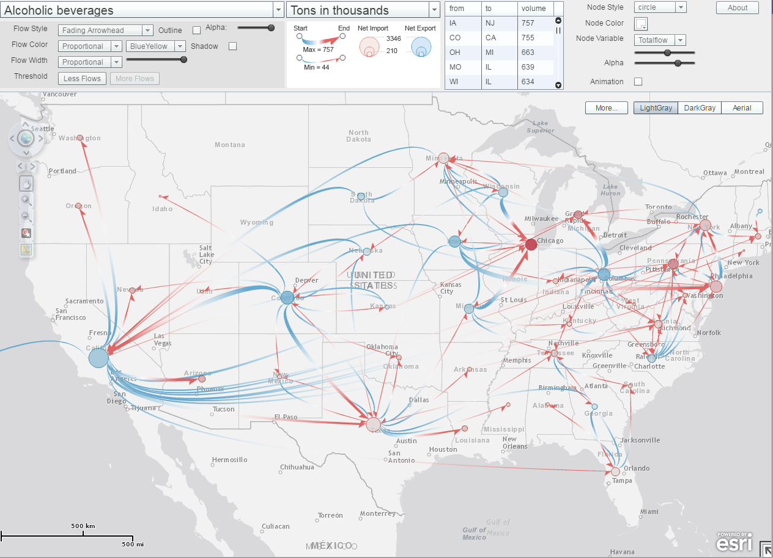
Flows of alcoholic beverages (2002 – 2007)
Koylu, 2016
Koylu, 2016: http://129.252.37.169:8400/flowvis/commodity/index.html

Slide 45
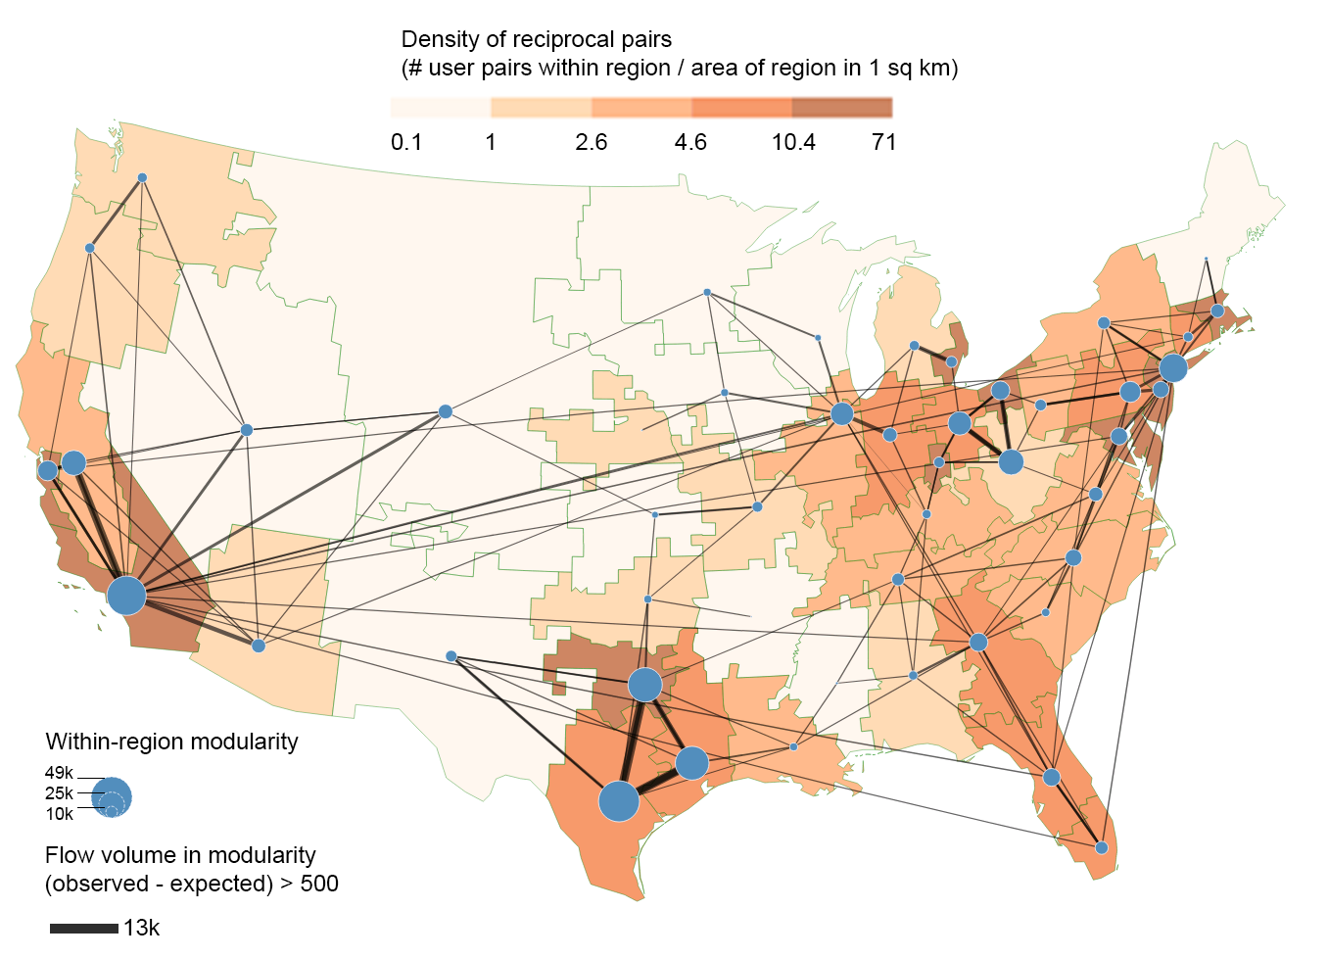
Reciprocal communication on Twitter (Aug. 2015 – 2016)
Koylu, 2017

Slide 46
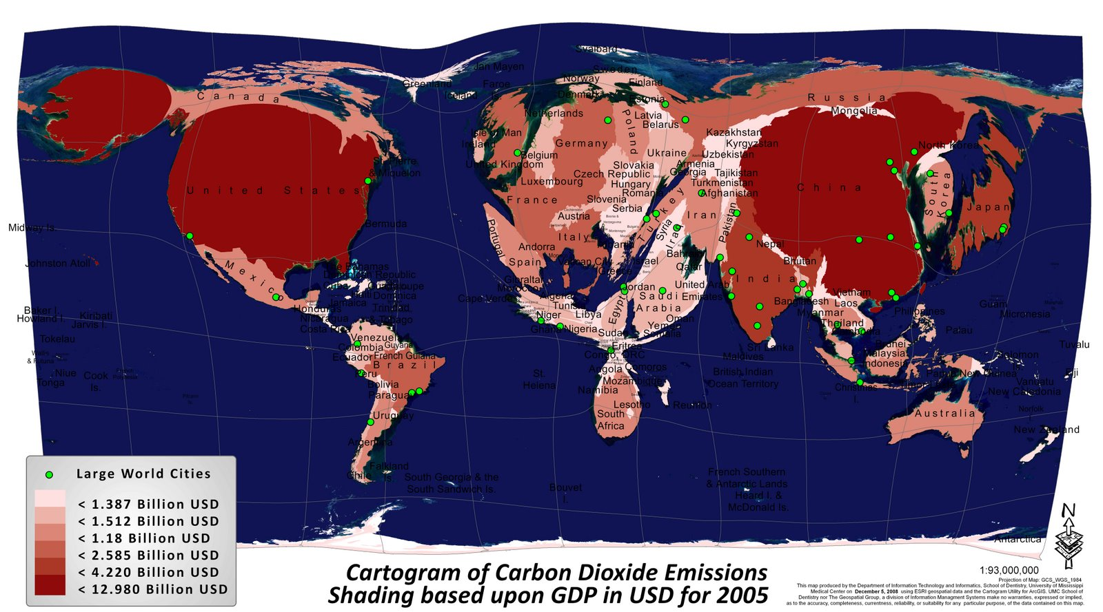
Cartogram
A cartogram is an abstract map in which geographical areas are exaggerated or distorted in proportion to the value of an attribute

Slide 47
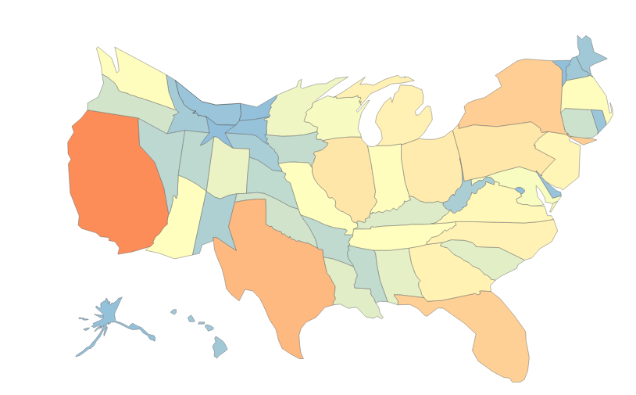
Cartogram

Slide 48
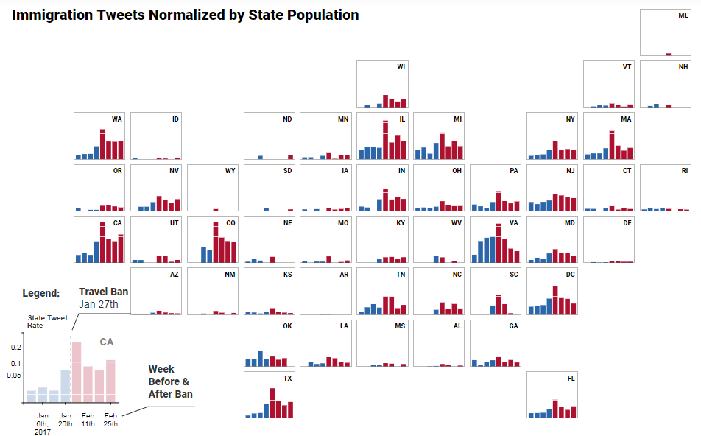
Cartogram

Slide 49
Choropleth maps
A choropleth map displays derived data with colors. The derived data usually are classified prior to mapping. The appearance of a choropleth map can be greatly affected by data classification

Slide 50
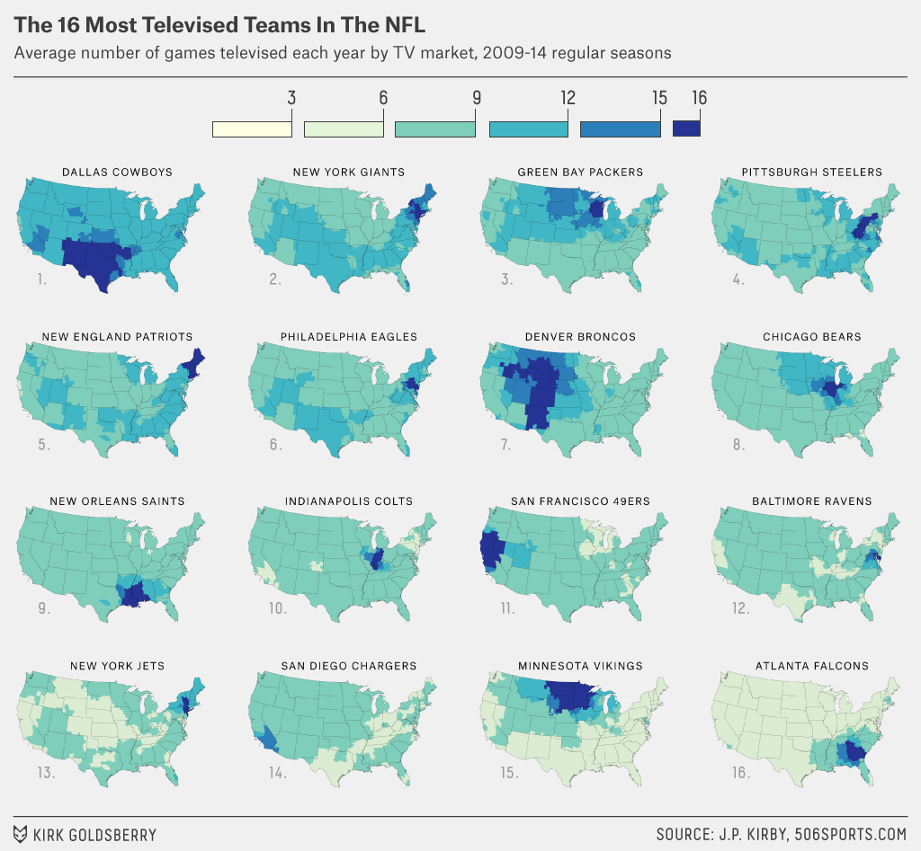

Slide 51
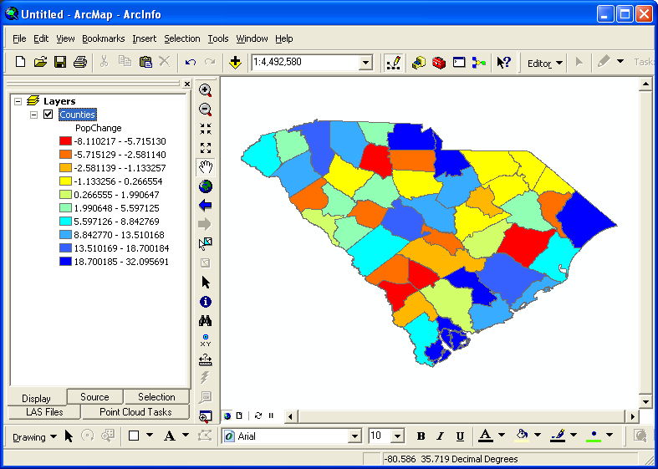
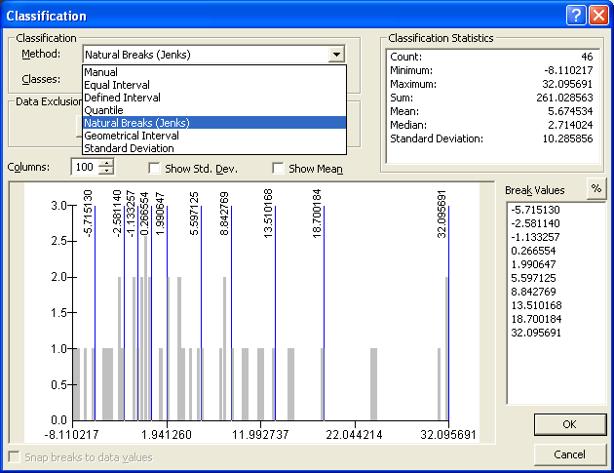
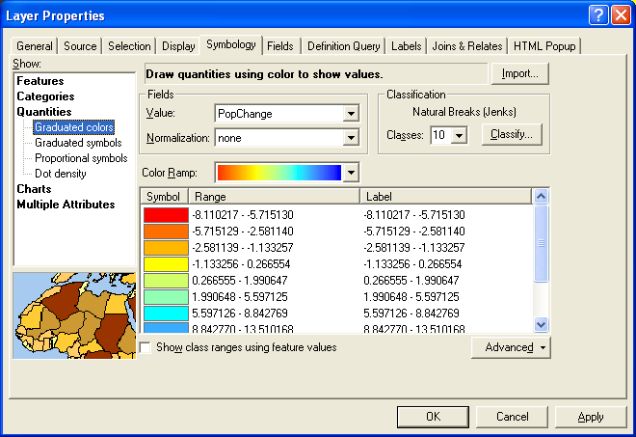
How do I classify my data?
Notes:
Equal Interval
Grouping observations by using class intervals of an equal range (1-25, 26-50, 51-75, 76-100)
Quantile
Each class contains the same number of features. May not be suitable for population counts because some areas have larger populations
Standard Deviations
Class breaks above and below the mean at intervals of standard deviations. Make sure data are normally distributed.
Natural Breaks
(A.K.A) Jenks method: it minimizes the squared deviations to the class means.

Slide 52
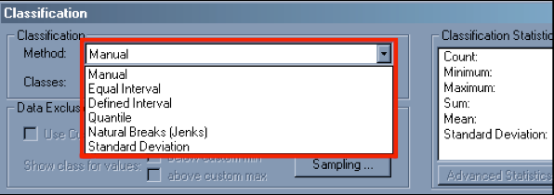
How do I classify my data?
Again, 3-7 data classes
Fewer classes may lead to overgeneralization, more classes may lead to issues in distinguishing between classes
Use histogram viewer in Arc (or other software to look for clusters)
Can help determine number of clusters and where breaks between classes might exist
Create/view histograms and maps with different classification methods

Slide 53
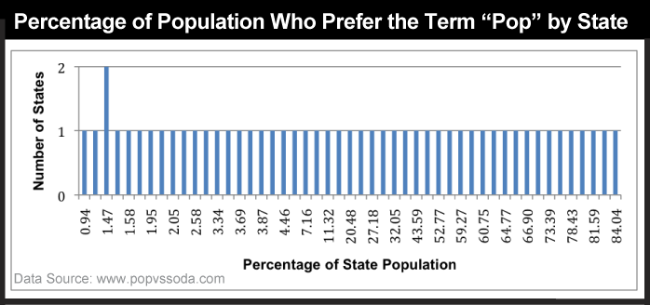
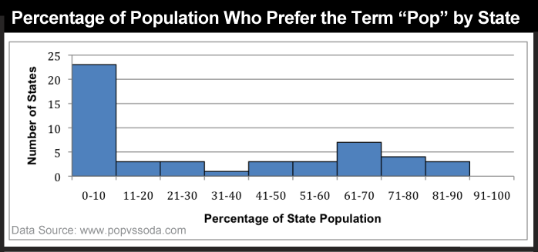
How do I classify my data?
Unique values usually not informative for this type of mapping
10 classes with equal 10% ranges more informative, but too many classes to map

Slide 54
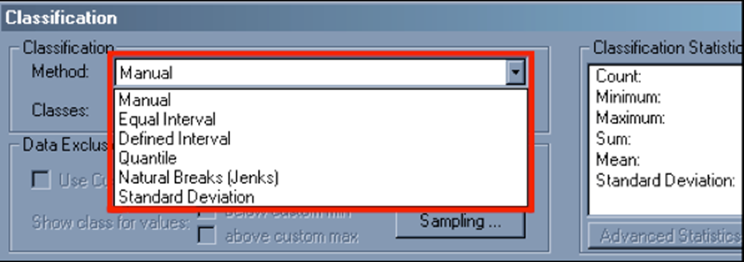
Types of classification schemes?
Three commonly used schemes:
Equal Interval: data divided into equal size classes
Quantiles (n-tiles): data divided into equal number of observations in each class
Natural Breaks: “optimal” scheme that finds gaps between data values

Slide 55

Classification schemes
Your data set: {42, 50, 55, 57, 61, 77, 79, 97}
Equal interval
Three classes based on range 40 to 100
Data divided into equal class sizes of 20 units
Class groupings: {42, 50, 55, 57}; {61, 77, 79}; {97}
Class ranges: 40-59; 60-79; 80-99 (classes have to be exclusive)
Class breaks

Slide 56

Classification schemes
Your data set: {42, 50, 55, 57, 61, 77, 79, 97}
Quantile (n-tiles)
Quartiles (lowest ¼ of observations, next ¼, etc.)
Data divided into equal number of observations in each class
Class groupings: {42, 50}; {55, 57}; {61, 77}; {79, 97}
Class ranges uneven: lots of options, one depicted below
Class breaks

Slide 57

Classification schemes
Your data set: {42, 50, 55, 57, 61, 77, 79, 97}
Natural Breaks
Data grouped by gaps in range of data values
{428505552574616772791897}
Data grouping: {42} {50, 55, 57, 61} {77, 79} {97}
Class ranges uneven: lots of options, one depicted below
Class breaks

Slide 58






Upper right: Equal interval
Bottom left: Quantiles (5 classes)
Bottom right: Natural breaks

Slide 59

Modifiable Areal Unit Problem
The three maps above show how different aggregations of count data (e.g., using three different types of enumeration units) can affect the appearance of a choropleth map created from the aggregated data.
The aggregation units contain different counts of the phenomenon, even though all three maps use the same color scheme and classification.
As you see, the effects of MAUP can significantly alter the appearance of the final map.

Slide 60

Use of color
Success of thematic maps, especially choropleth maps, depends on how we manipulate color in terms of hue, saturation, and value
Hue: color without black or white added
Saturation: the amount of pure color; 0% = gray, 100% = pure hue
Value = brightness: 0% = dark, 100% = white (bright)

Slide 61

Use of color: rules
Type of thematic data determines your color scheme
Shading generally progresses from dark to light
Dark is associated with high values

Slide 62

For help on color schemes visit sites like ColorBrewer 2.0 or ProCato.com

Slide 63

Color selection: www.colorbrewer2.org

Slide 64
Questions?
@caglarkoylu
caglar-koylu@uiowa.edu
www.geo-social.org/datascience

